Slide 1

CityCent : Unlock Safer Roads

Slide 2



Why does Road Safety Matter ?
Roads are the most frequently used form of transportation, with millions of vehicles, pedestrians, and cyclists sharing the space daily.
Air and sea travel account for longer distances, accidents in these modes are statistically far lower compared to road travel.

Slide 3



More than 1.35 million people die in road traffic accidents annually, making road transport the deadliest form of transport (WHO).
Air travel is statistically the safest, with fewer than 500 deaths per year on average globally.
Marine accidents are rare, with lower numbers of fatalities compared to road transport.
While air and sea travel are more controlled and heavily regulated, the high volume of land-based transport makes roads particularly vulnerable to accidents and injuries.

Slide 4

The Challenges of Modern Road Safety
Despite traffic rules and safety measures, accidents still occur.
Causes: distracted driving, poor weather conditions, or malfunctioning traffic signals.
Real-world consequence: unpredictable hazards for road users.

Slide 5

Analysis Summary
High average speed zone:
The average speed zone for accidents is 133.02 km/h, indicating a high average speed of vehicles involved in accidents. This poses a significant risk to road safety and requires immediate attention. Average accident severity:
With an average severity of 2.60 on a scale of 1-4, there is a need to focus on reducing the severity of accidents and improving overall road safety measures. Involvement of multiple vehicles and persons:
On average, 1.82 vehicles and 2.34 persons are involved per accident, suggesting a need for strategies to address multi-vehicle and multi-person accidents. Common road type and vehicle type:
The most common road type for accidents is "ROAD," and the most common vehicle type in accidents is category 1. This information can help in targeting specific areas and vehicle types for road safety improvements.

Slide 6
Recommendations
Time-Based Traffic Management
Urban Infrastructure Improvements
Speed Management
Targeted Driver Education
Vehicle Safety Promotion
Environmental Adaptations
Traffic Control Enhancements
Rural Road Safety
Data-Driven Approach
Public Awareness and Education

Slide 7
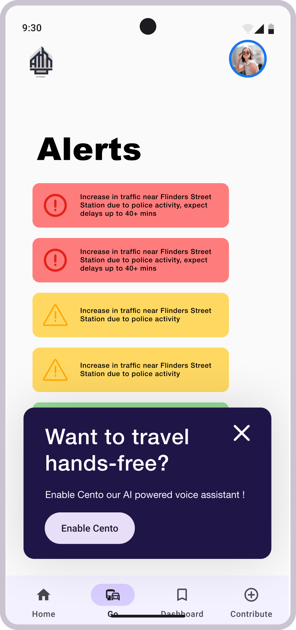

AI-Driven Insights for Safer Roads
A mobile app that provides real-time alerts and safety tips.
Personalized for drivers, pedestrians, and cyclists.
Dashboards for authorities to monitor, predict, and manage road safety.

Slide 8
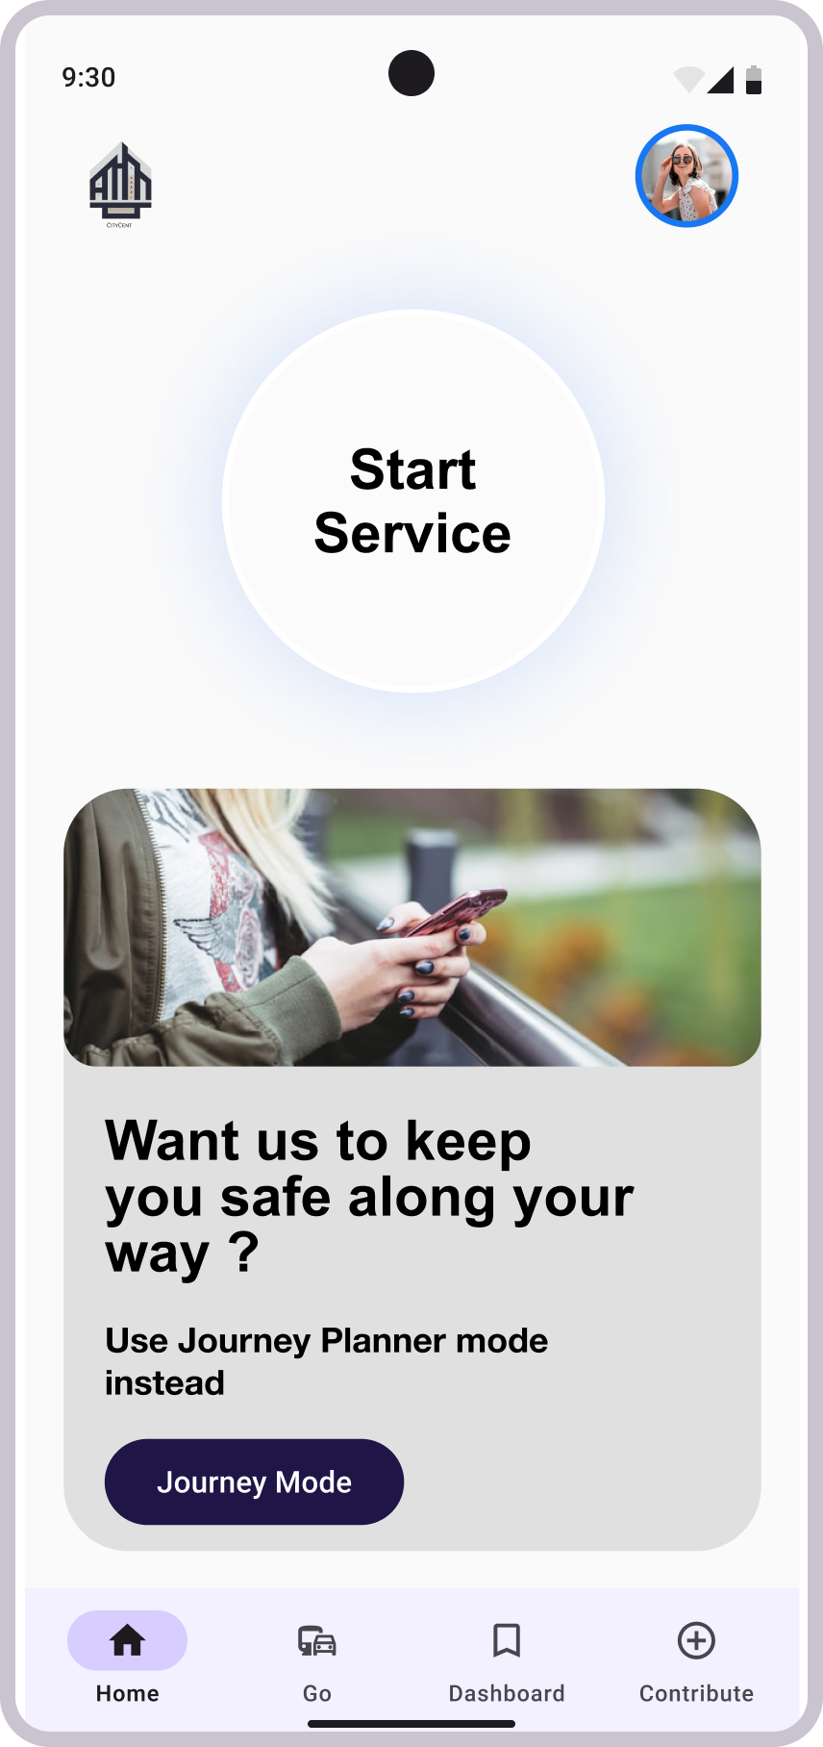
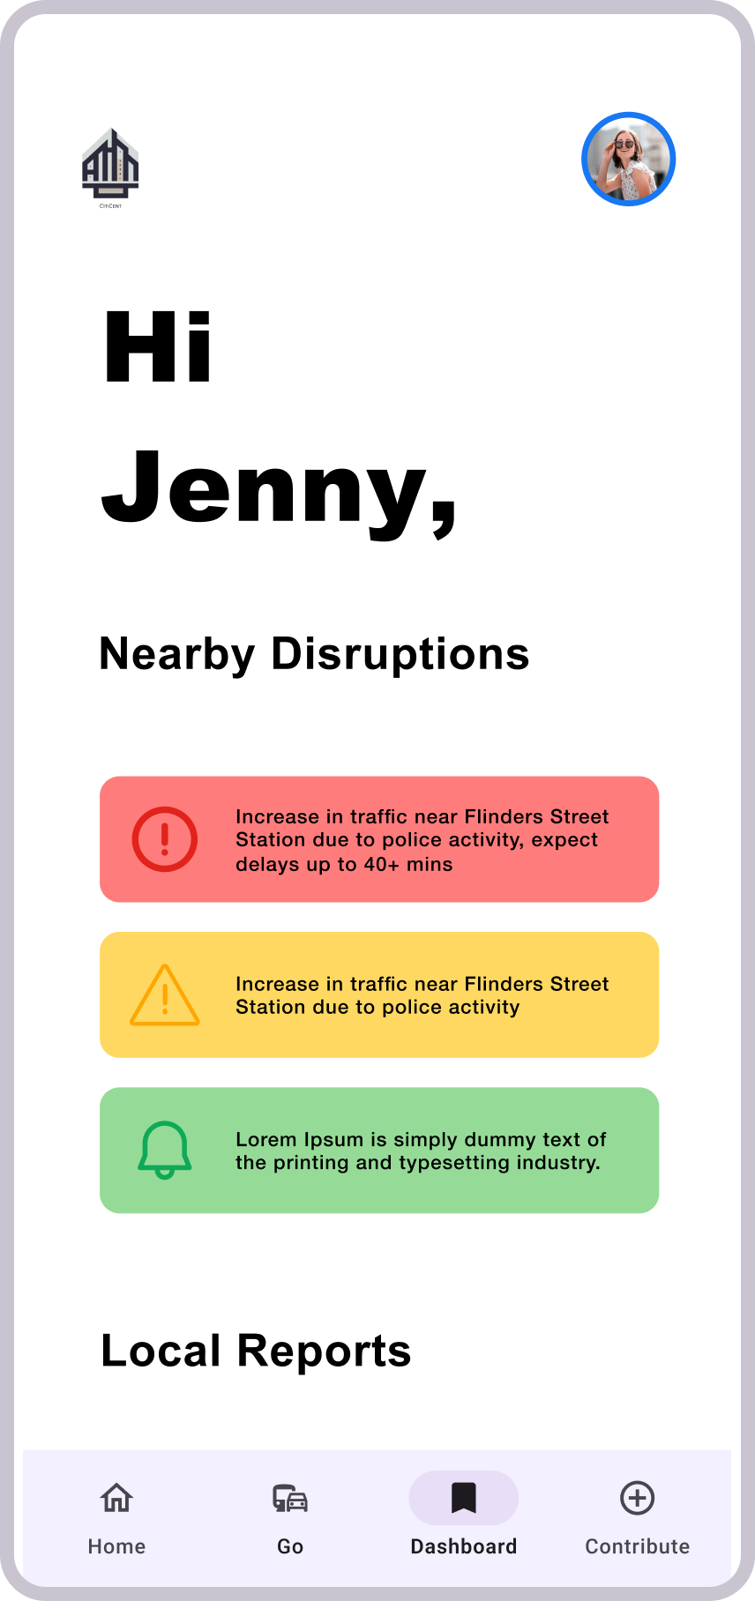
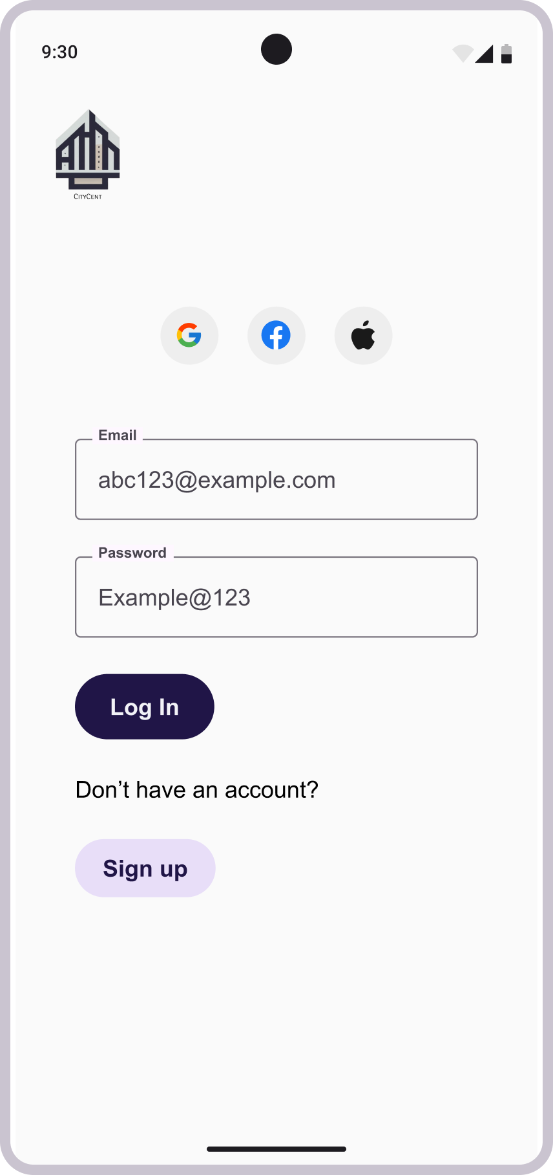
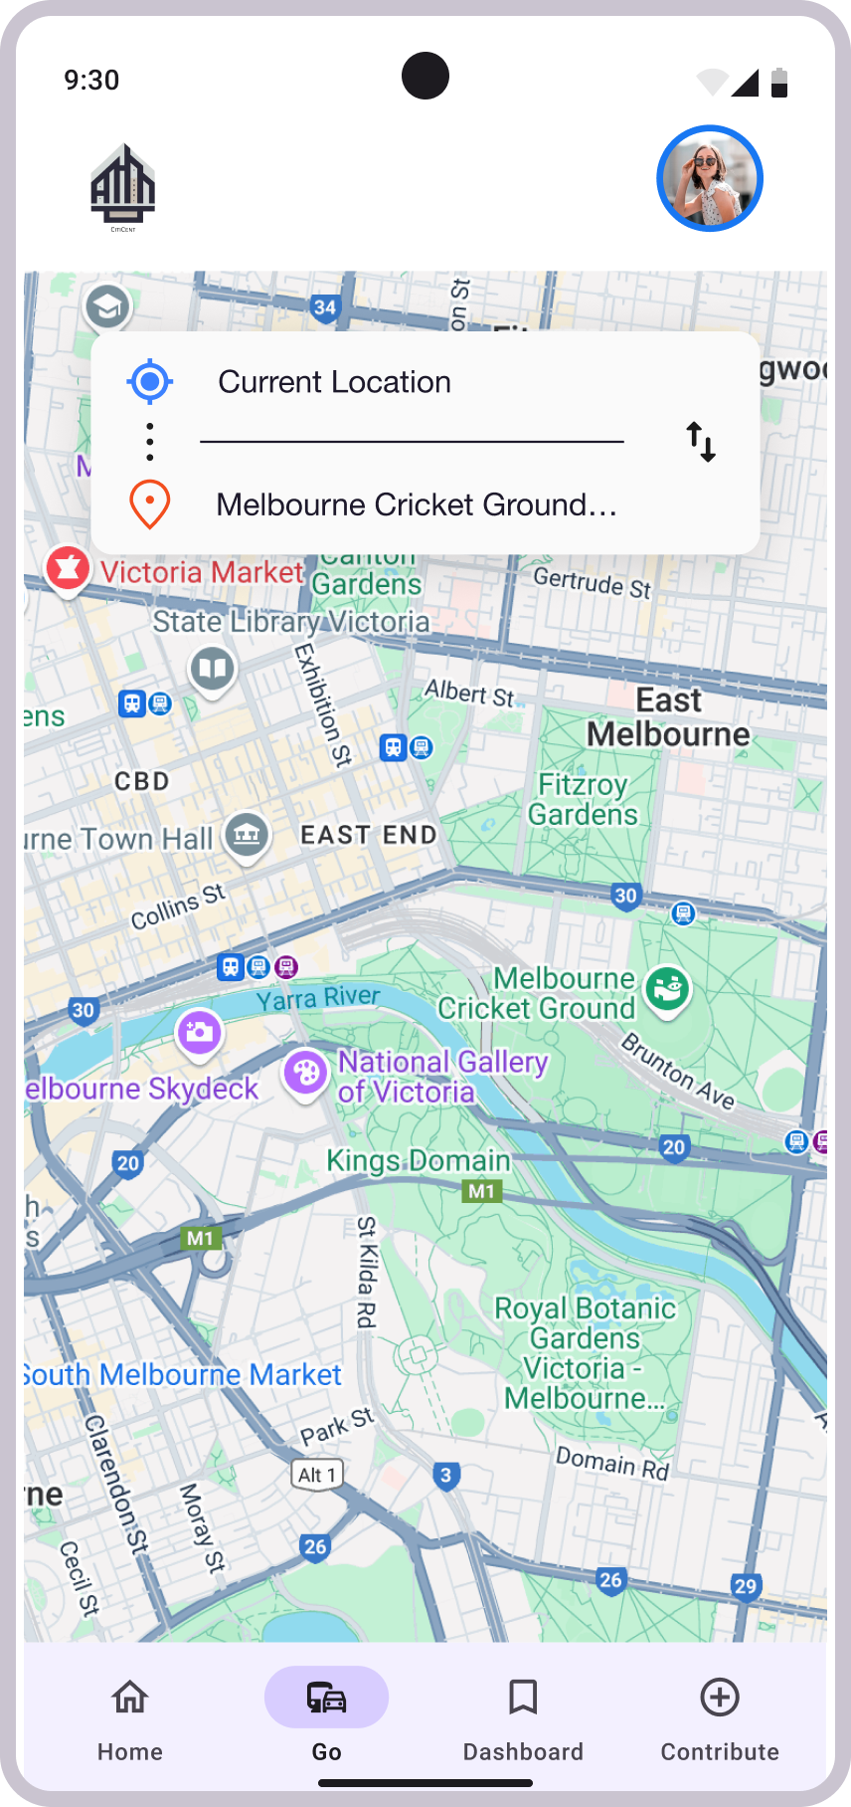
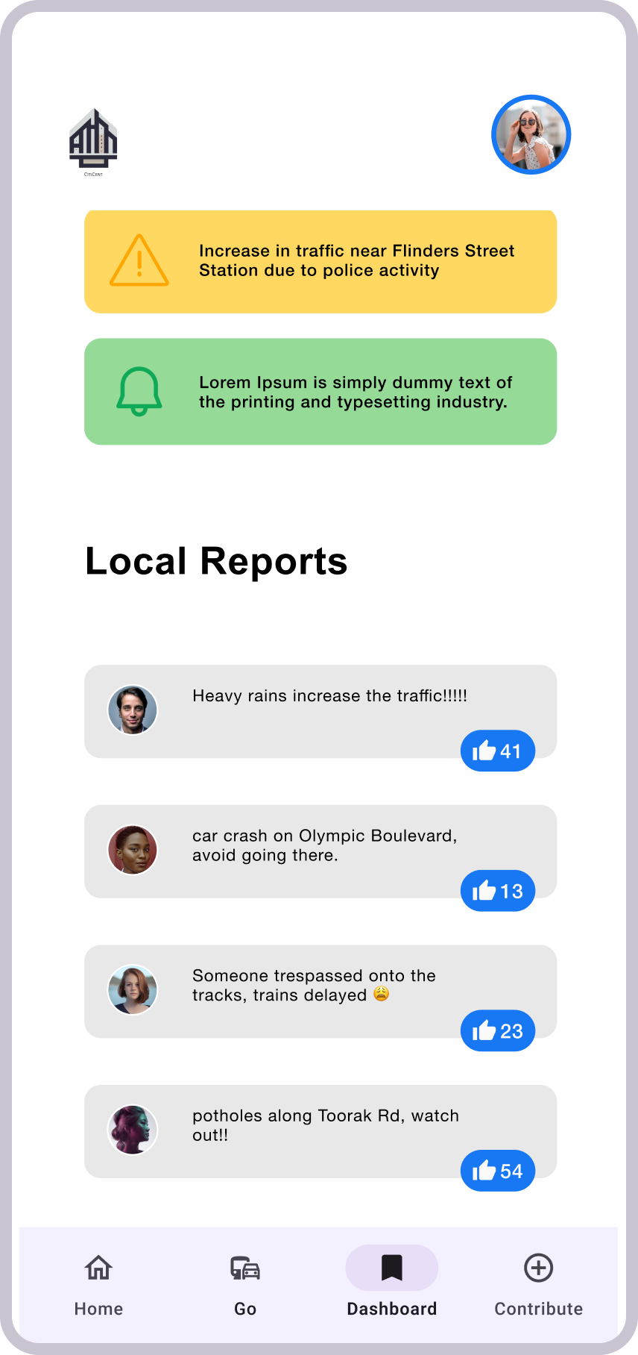
Citizen App Screens

Slide 9
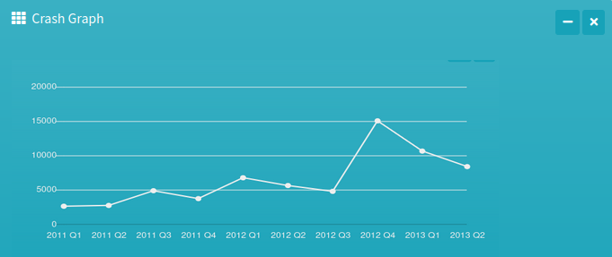
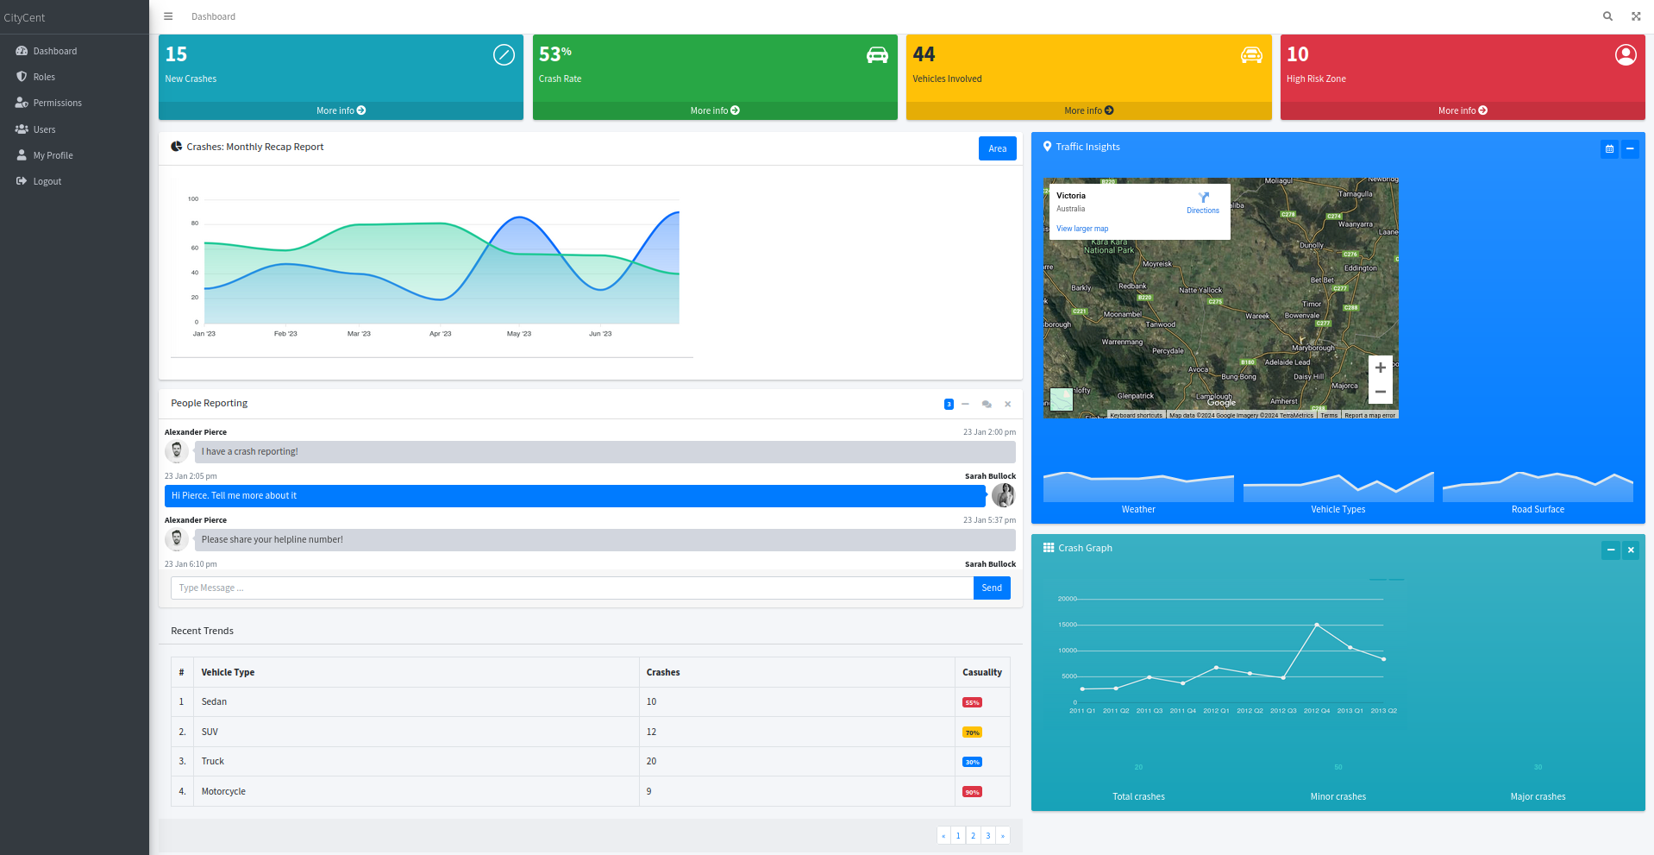
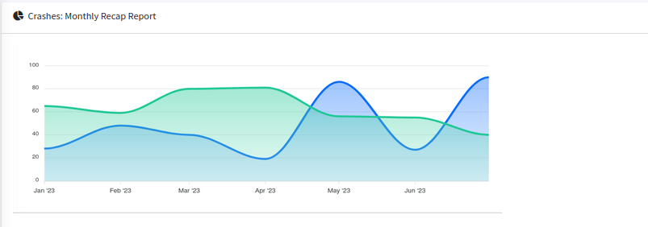
Authorities Draft Screens

Slide 10
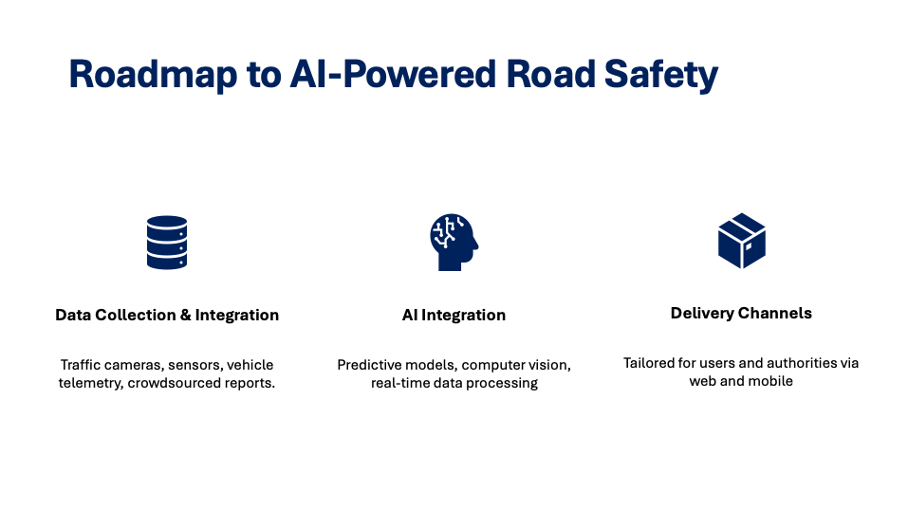

Slide 11



Empowering Authorities with Actionable Data
Monitor live traffic, congestion, accident-prone zones.
Predictive analysis for safer road design.
Incident alerts and emergency response optimization.

Slide 12


Road safety System Solution View
User App
User Data
Information Delivery Backend
User Data
Geo location
Citizen reporting
Model training & prediction
AI Models
User alerts, dashboards
External Data
Accident risk prediction
Model training & prediction
Accident reporting data
LLM agent for executive brief
Admin , Planners
Traffic API
Monitoring dashboards,
Analytics
Weather API

Slide 13
Testing, Feedback, and Scaling for Success
Pilot testing with city authorities.
Continuous feedback from users and authorities.
Scaling through partnerships with automakers, smart cities, and other stakeholders.

Slide 14

Policy Recommendations
Data-Driven Infrastructure Policies Proposal
Regulations on Vehicle Telemetry Sharing Proposal
Mandating Real-Time Road Safety Alerts Proposal
Crowdsourced Reporting Integration Proposal
Data Privacy and Security Measures Proposal
AI-Driven Traffic Management Policies Proposal

Slide 15

AI-Powered Road Safety: A Smarter, Safer Future
AI promises a revolutionary leap in road safety, however its successful adoption hinges on addressing challenges such as regulatory updates, technology integration, and user education. By overcoming these hurdles, we can create a safer, smarter future on our roads.
Thank you.

